Slide 1

COMPONENT 3
BUS 343- E100 (E107)
SOUR
Cheers to the people who make change.
Spencer Eschyschyn
(301465591)
Paul Thomas
(301438338)
Asif Hasan
(301376671)
Jasleen Kaur
(301451792)
Liz Gilder
(301391429)

Slide 2
Marketing Mix
(Component 3)

Slide 3
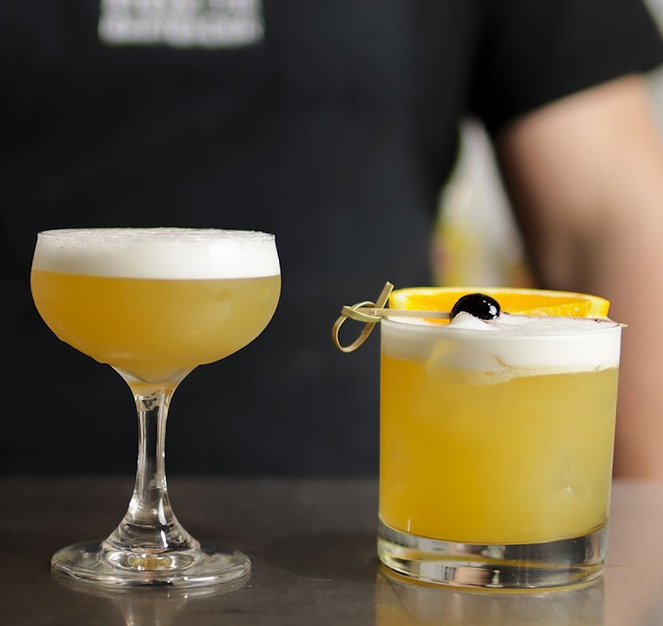
Introducing… SOUR
Product
Who?
SOUR is a Vancouver startup founded by five SFU students looking for a convenient and eco-friendly way to consume our favourite drink.
What?
We combine affordable cocktails at home with environmentally friendly packaging. Because our product is a mixer, it can be sold anywhere.
Why?
We’re SOUR about climate change. Everyone should be able to have their favourite drink, always- if that means investing in our worlds’ environmental future, so be it.

Slide 4
Marketing Mix Summary
Summary
P
roduct
rice
P
Eco-friendly and innovative packaging
Fun, yet stylish branding that conveys both product excellence and “SOUR” name
Affordable and competitive pricing that outweighs competitors
Pricing in alignment with the BC urban millennial’s needs
P
lace
P
romotion
Secure partnerships with both suppliers and retailers
D2C channels via e-commerce purchasing
3 Pillars of Promotion:
Digital Presence
Personal Selling
Word of Mouth

Slide 5
Marketing Mix Summary
Summary
P
roduct
rice
P
Eco-friendly and innovative packaging
Fun, yet stylish branding that conveys both product excellence and “SOUR” name
Affordable and competitive pricing that outweighs competitors
Pricing in alignment with the BC urban millennial’s needs
Through implementing targeted pricing, place, and promotion, the SOUR product will effectively reach urban millennial consumers residing in British Columbia. The four P’s of the marketing mix will work cohesively to establish a brand perceived as environmentally-friendly, affordable, and fun- each of which are aligned with the millennial consumer.
P
lace
P
romotion
Secure partnerships with both suppliers and retailers
D2C channels via e-commerce purchasing
4 Pillars of Promotion:
Digital Marketing
Personal Selling
Television
Word of Mouth

Slide 6
Product

Slide 7


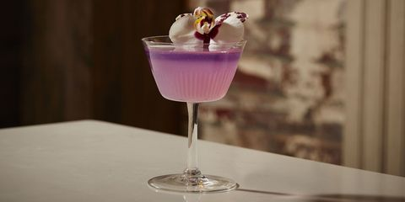
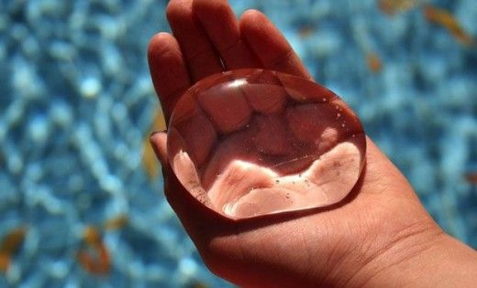
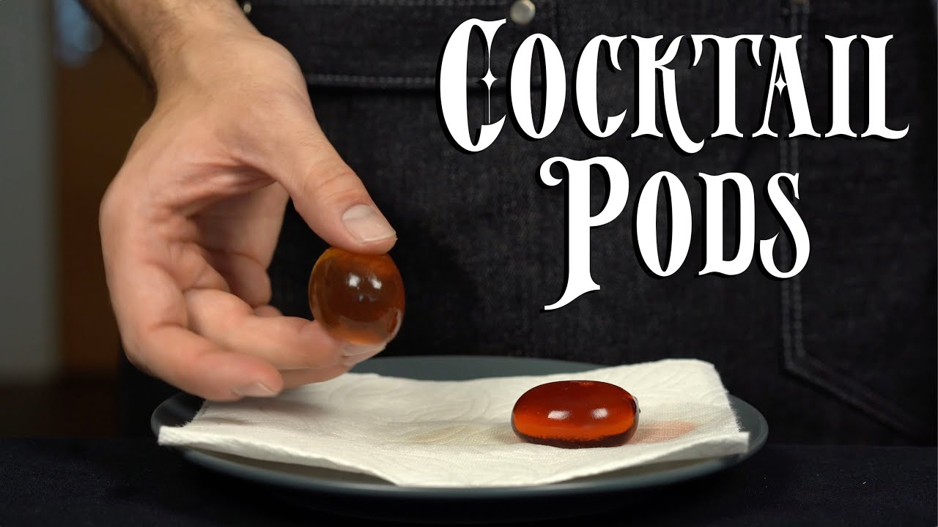

#drinkathome
SOUR

Slide 8
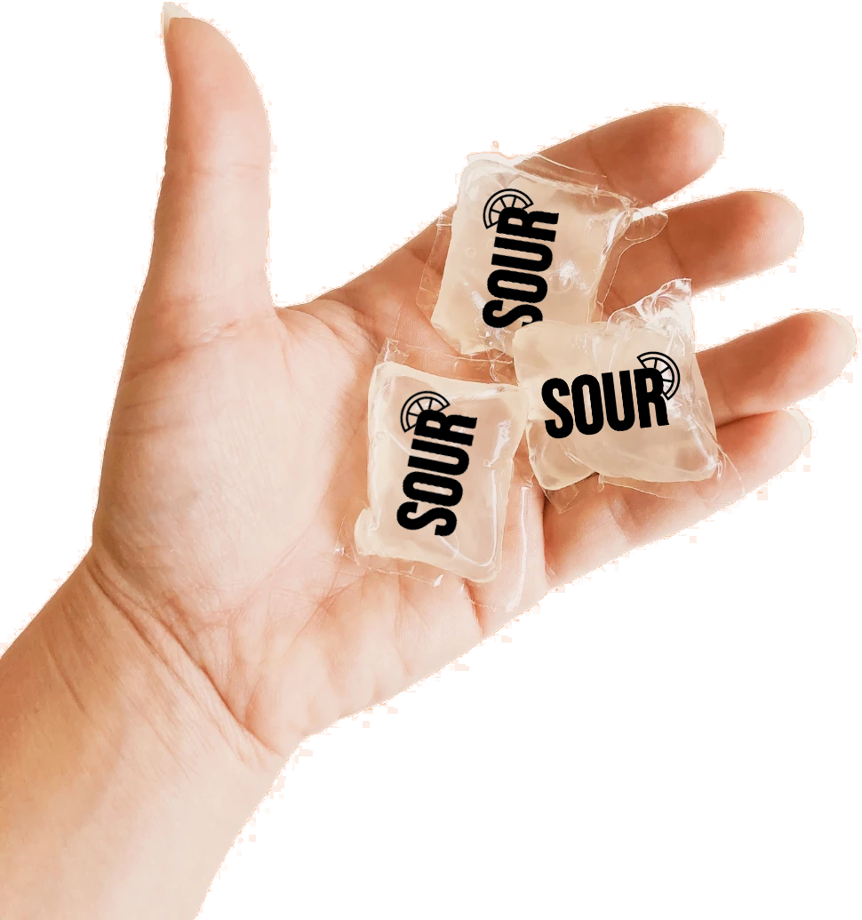
What is SOUR?
Product
Product Features
1
Ingredients:
1 oz Lemon juice
1 oz Simple syrup
Dried cherry- improvement
Innovative product style
2
Pod Packaging:
Ooho seaweed disposable pod (single)
65 ml (2.2 oz)
Pack of 6
Dimensions: 6” x 3” x 2”
Pack of 18 (Value-pack)
Dimensions: 6” x 6” x 4”

Slide 9
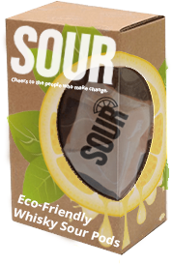
What is SOUR?
Product
Product Features
3
Product Associations:
Eco-friendly & innovative packaging style & brand- Ooho, for environment conscious consumers
Plus, draw more people towards eco-friendly products
Convenience of enjoying alcoholic cocktails instantly (on-the-go)
4
Packaging and Branding:
Bright colours to catch the eyes of consumers
Branding conveys high-quality and product excellence to customer
Entire product package is recycled cardboard and plastic
SOUR pack of 6 mock-up

Slide 10
What is SOUR?
Product
Justification
Sour fits the current target segment- Millennials of Urban BC, moreover, the product due to its features has the potential to reach other similar segments within Canada, for example- Urban Millennials of Alberta. Thus, marketing the product successfully and sustain the business could result in a much larger market size in the future years.
Based on facts of the target segment:
From fact 1 (Forum Research, 2016), Millennials of urban BC is more likely to be the early majority in the adoption cycle of the product
From fact 2 (Conway, 2020), Canadians residing in the urban areas are more willing to spend on convenience products due to higher income demographics
From fact 3 (Fong, 2017), Canadians that fall under middle-higher income class tends to spend more on consumption of alcohol

Slide 11
Price

Slide 12
Costs Breakdown
Pricing
Ingredient Cost / Unit
Additional Cost / Unit
Lemon Juice $0.10
Simple Syrup $0.05
Packaging Cost $0.025
$0.88/Unit*
OR
Cost of a pack of 6 = $5.28
Cost of a pack of 18 = $15.84
Seaweed Pod $0.25
Marketing Cost ~ $0.35
Other Flavourings $0.10
**includes GST and PST
*Costs will decrease if production increases; a higher rate of production could mean a decrease of almost 50% of the current variable cost
Considering SOUR’s BEP unit is $1.40, it is imperative that we price the product above $1.40

Slide 13
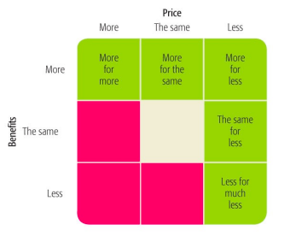




Market Factors in Pricing
Price
Competition
Price: $1.49 USD/unit ; unavailable in Canada, no pod
SOUR
Price: $1.58 USD/unit ; unavailable in Canada, no pod
Price: $4.01/USD unit ; no pod
Price: $3.99 CAD/unit ; requires the use of a $399.99 machine
SOUR’s closest competitors offer a mid-high price range, often requiring a machine to utilize pods

Slide 14
Market Factors in Pricing
Price
Competition
Price: $1.49 USD/unit ; unavailable in Canada, no pod
SOUR
Price: $1.58 USD/unit ; unavailable in Canada, no pod
Through utilizing competition-based pricing, we can conclude that $1.92 - $5.13 CAD is an appropriate price range for a single SOUR pod, offering further discount for a bulk quantity.
Price: $4.01/USD unit ; no pod
Price: $3.99 CAD/unit ; requires the use of a $399.99 machine
SOUR’s closest competitors offer a mid-high price range, often requiring a machine to utilize pods

Slide 15
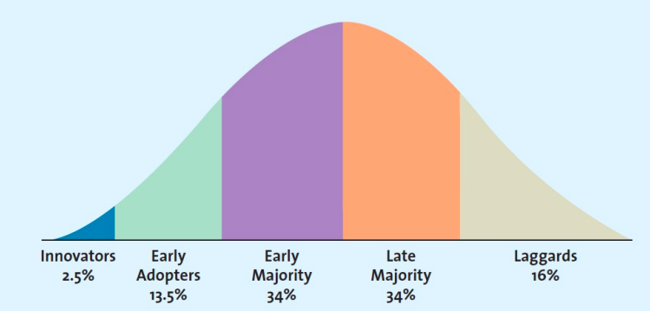
Pricing for SOUR’s consumers
Price
Heightened consumer price sensitivity
Urban Millennial
Annual Income:
Millennials in Canada have a median household income of $44,093 (Evans, 2019)
Insights:
The cost of living in BC is 3x greater than the average millennial can afford (Connelly, 2019)
Consumers are less sensitive to price when the total cost is low compared to their total income
SOUR
Considering our current startup status, lack of market presence, and the price sensitivity of consumers, SOUR must have a penetrative pricing model in order to succeed in the market.

Slide 16



SOUR’s Pricing Strategy
Price
Product Pricing
Strategy
Competition-based pricing
Total cost / unit ~ $0.88
Cost of a pack of 6 = $5.28
Cost of a pack of 18 = $15.84
6-pack vs. 18-pack (respectively)
Wholesaler: $8.80 & $19.59
Retailer: $9.49 & $20.29
D2C: $10.99 & $21.99
Tactic
Price bundling- minimum 6 pack
Price Reduction
Bulk quantity value pack discount
Through pricing SOUR below competitors, we can establish a strong foothold in the market, align with target consumers, and reap sustainable profits

Slide 17
Break-even Analysis
Pricing
Strategic Plan for Production
Number of units: 18,000 pods ~ 3,000 6-packs
Total cost: 18,000*0.88 = $15,840
$0.88 per unit
Total profit: 18,000*3.5 = $65,000
$3.50 per unit
Break-even Units:
Initial cost / Gross per unit
= 20,000 / 3.5
= 5,715 units
Therefore, we will have 12,285 units over the break-even units
Ensures business profitability and sustainability
Initial Cost: $20,000
As ooho will be responsible for production of Sours, we do not have a definite fixed cost but we expect to invest $20,000 to initiate the business connections, production and distribution channels, and finally to position the product in the market
Initial (Fixed cost) = $15,840 (production costs) + $4,160 (Misc. costs)

Slide 18
Place

Slide 19






Partnerships for success
Place
Suppliers
Retail Partners
D2C
Local Farms
Establishing Relationships
Partners must satisfy both criteria
Notpla
- Offers environmentally friendly packaging solutions made from Notpla, a material made from seaweed and plants that disappears naturally
- Emphasizes our commitment to sustainability/saving the environment and supporting innovative companies that focus on reducing plastic waste
- Sour pods support local businesses by sourcing ingredients from local farmers
- Allows for more control over lead times and reduces supply chain risk
Value
alignment
Cost Efficiency

Slide 20


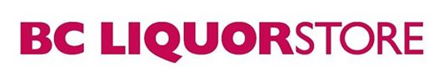
Partnerships for success
Place
Suppliers
Retail Partners
D2C
Private and Government Liquor Stores
Our product complements liquor products
Initial target partners include BC Liquor Stores, Jaks Beer Wine and Spirits, and West Coast Liquor Company
Urban Grocery Retailers
Reduces inventory risk by transferring ownership of inventory to retail partners
Receive competitive intelligence about customers
Niche retailers align with urban millennial trends
Initial targets include: Whole Foods, Thrifty Foods, and Fresh St. Market

Slide 21


Partnerships for success
Place
Suppliers
Retail Partners
D2C
E-commerce Strategy
On our website - customers are able to order our product straight to their home through our website
Distribution through Canada Post shipping from our warehouse
Achieve better margins by selling directly to the customer
Consumer data and touchpoints can be tracked easily; this means consumer targeting strategies can be adjusted down the line
Can easily gather consumer information such as email, location, etc. through UTM tracking and the implementation of a CRM software such as Salesforce

Slide 22



Justification: e-commerce can’t do it all
Place
E-commerce Advantages
E-Commerce Limitations
Previous insights:
From fact 2 (Conway, 2020), Canadians residing in the urban areas are more willing to spend on convenience due to higher income demographics
Additional insights:
70% of consumers may be routinely buying consumer packaged goods online in the next five to seven years (Trade News, 2018)
Millennials account for 33% of all online purchases (Canada Post, 2021)
In-Store Advantage
“77% more likely to make an impulsive purchase”
(Pedro, 2019)
Reduced Spending Ability
“Customers are now more selective when
making a purchase online” (Wixcey, 2014)
Missing Social Aspect
Absence of “Crowd Effect” - consumers are not
influenced in the same way by one another online
Though e-commerce is valuable when reaching our target segment, SOUR cannot exclusively rely on an e-commerce strategy

Slide 23
Promotion

Slide 24



How SOUR will create brand awareness
Promotion
Different Stages of Customer Adoption
Marketing tactics
Digital Ads
Being a start-up Sour Pods isn’t “made of money” and thus will have to choose where and when to spend carefully. That being said, digital ads are affordable, easy to use, and can reach massive amounts of consumers on a daily basis. SOUR will be utilizing Instagram, Youtube, and Google Ads to reach the millennial consumer. Through the use of Google Ads and Google Analytics, SOUR can analyze consumer trends and adjust our marketing model based off of them.
Messaging: “We’re SOUR about climate change”
Key Words:
Whisky Sour, SOUR pods, Whisky, Cocktails at Home
Awareness
Interest
Engagement
Repeat
Harness Buying Intent
Youtube advertisements are more engaging
Build up User-Generated Content

Slide 25
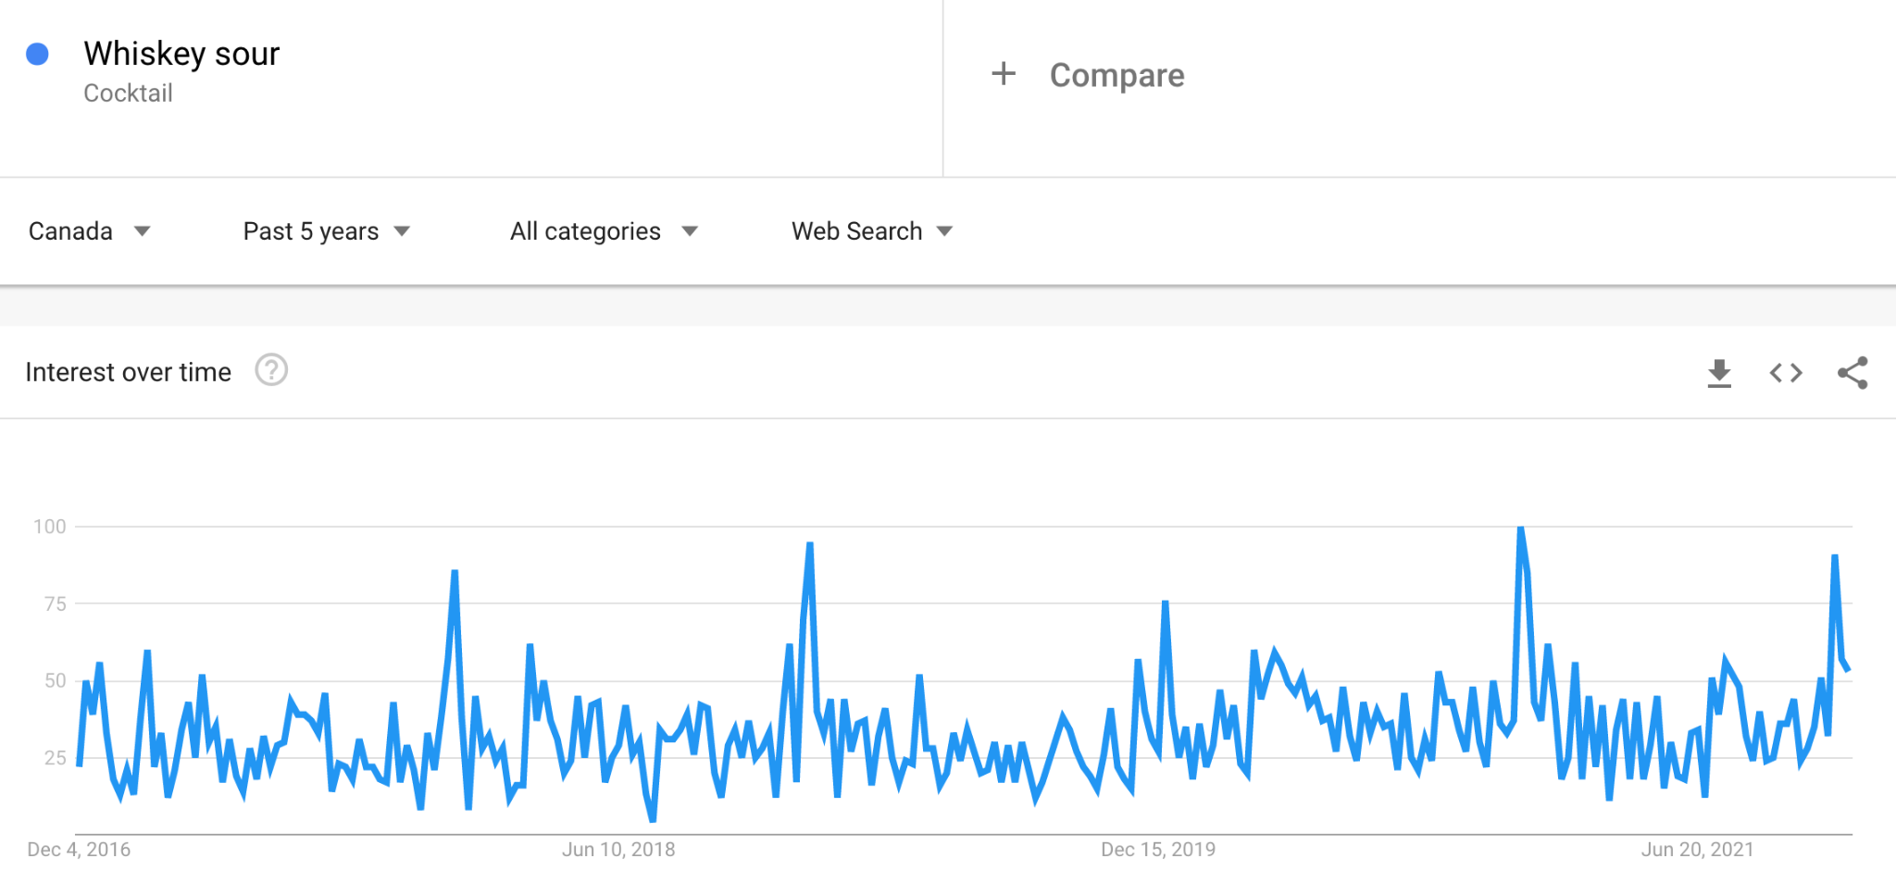
How SOUR will create brand awareness
Promotion
Different Stages of Customer Adoption
Marketing tactics
Google Ads Schedule
Pulse Advertising: Pulsing advertising schedule - Whiskey sour has steady demand all year round although more resources could be used during the month of december when it is most popular (identified by using google analytics trends - large spikes seen on chart are in december).
Awareness
Interest
Engagement
Repeat
Source: Google Analytics

Slide 26


How SOUR will create product interest
Promotion
Different Stages of Customer Adoption
Marketing tactics
Partnerships with KOLs (Key Opinion Leaders)
Through partnering with KOLs (otherwise known as social media influencers), SOUR can reach a targeted demographic, have a wide reach, and receive product endorsements. In turn, the influencers’ following will become interested in SOURs’ products.
Awareness
Interest
Engagement
Repeat

Slide 27

How SOUR will encourage brand desire
Promotion
Different Stages of Customer Adoption
Marketing tactics
Strong social media presence
Awareness
Through conveying a strong presence across SOUR’s Instagram, Twitter, and Tik Tok, we can educate our customers, and position ourselves as witty thought leaders whilst creating engagement. The Sour Pods social media will be mainly focussed on posting short clips on Sour Pods, stories and experiences from satisfied consumers, and actively communicating with consumers.
Content:
While Sour Pods is serious about saving the environment, we also wants to promote having fun with our product, so every month Sour Pods will have a contest online where customers can send in videos of themselves whether it's consuming them in a unique way or place. The winner will be the next month’s feature advertising video, along with a three month supply of Sour Pods.
Interest
Desire
Repeat

Slide 28

How SOUR will encourage consumer action
Promotion
Different Stages of Customer Adoption
Marketing tactics
Personal Selling
Awareness
Sour pods can use sales people at liquor stores to offer (virgin) taste testing and promote the product directly to the consumer. Sales people can also educate customers on the benefits of sour pods such as environmentally friendly packaging, unique/quality taste and ingredients sourced locally, and wide variety of distribution channels which makes it easy for consumers to purchase the product.
Interest
Desire
Action

Slide 29
Strategic Plan
- We are aiming to position ourselves into our consumers minds as a trendy, environmentally sustainable, convenient, and cost friendly cocktail mix. By using a differentiated marketing strategy, we will be targeting BC urban millennials in the first year, then expanding into Alberta 2023.
- Our four P’s show the constant theme of being a sustainable, affordable, and a convenient substitute to traditional mixers. We will communicate the value of our proposition through digital media, brand marketing (word-of-mouth) and personal selling.
- We provide sustainability through biodegradable packaging, affordability through low production costs/bundle pricing, and convenience by allowing our consumers to pick one of our many retailers or even buy directly using ecommerce to acquire out product.
SOUR
Cheers to the people who make change.

Slide 30
Strategic Plan
- Product/Price: By supplying a product that is superior in both quality (locally sourced ingredients) and environmental awareness at a competitive/lower cost that our competitors, we will stand out as the superior alternative.
- Product/Place: Since our product is a mixer, we are not limited by local liquor laws to only offer our product in restaurants or the limited amount of liquor stores in BC. Instead, we will offer our product in grocery stores, gas stations, or even online through e-commerce. Due to the convenience of our product, we will be able to take advantage of the growing amount of consumers who value convenience in their purchase decisions.
- Price/Place: Because our product is both affordable and not restricted by local liquor laws, we are able to use these advantages to target convenience consumers at a variety of retailers who brand themselves as convenient. Since our product is cheap to produce we will not have to adjust this for retailers with traditionally cheap products (ex. gas stations).
SOUR
Cheers to the people who make change.

Slide 31
Strategic Plan
- Price/Promotion: While our product is already affordable, we will be offering both a bundling offer (cheaper to purchase 18 pack vs 6 pack) and a loyalty program that is committed to rewarding our consumers for purchasing our biodegradable product and boycotting plastic containers.
- Promotion/Place: Integrating UTM link tracking to track consumers and utilize customer data analytics when developing future e-commerce marketing strategies.
Specific goals for company:
1. Generate Website Traffic: Receive over 200,00 views of the company website within the first year, with a 25% growth of views annually.
2. Establish Brand Awareness: Increase the brand awareness by 25% using social media channels (Instagram, Snapchat, TikTok), by the end of the 2nd quarter of 22.
3. Profitability: Make average net revenue of 5% ($20,000) by the end of the first fiscal year (2023).
SOUR
Cheers to the people who make change.

Slide 32
Key Takeaways from Past Deliverables
- Alcohol ecommerce grew by more than 40% in 2020.
- Opportunity to establish ourselves in a relatively new online marketplace for at home cocktails.
- Few competitors in this space.
- Competition isn't environmentally friendly & unavailable in canada so highlighting this in our message to consumers is a priority.
- Vancouver has a rural-urban income inequality that is 2.5x higher than the national average (Fong, 2017).
- BC has the largest market of whiskey consumers in Canada, with 20% of the population saying it is their favourite liquor for cocktails.
- Preparation Time: The RTD market has grown 43% globally (Swartz, 2020).
- Convenience to Make: Thanks to the pandemic, now more than ever, the ability to make cocktails from the comfort of your home is in trend. Consumers want to have fun and be adventurous (Swartz, 2020).
SOUR
Cheers to the people who make change.

Slide 33
IMplementation

Slide 34

Implement: The Marketing Mix decisions to start SOUR’s journey in Canada by the first quarter of 2022, to become a quality, innovative and environmentally friendly brand that its consumers can be proud to do business with.
How: By Using SMART Goals
GOAL 1: Receive over 200,00 views of the company website within the first year, with a 25% growth of views annually.
GOAL 2: Increase the brand awareness by 25% using social media channels (Instagram, TikTok), by the end of the 2nd quarter of 22.
GOAL 3: Make average net revenue of 5% ($20,000) by the end of the first fiscal year (2023).
SOUR
Cheers to the people who make change.

Slide 35

GOAL 1 BREAKDOWN
Web Traffic:
Use niche targeting by generating content that appeals to our target market. We know from our “Component 2” of the marketing plan, about our target person, but to create awareness surrounding our target demographic and we will use social media influencers and digital ads to target niche consumers.

Slide 36
GOAL 2 BREAKDOWN
We Are New, But We Don’t Have to be Cold:
We will do this by posting personal, human-centric content. This will include promotions, customer re-posts, selfies of our employees enjoying the drink as well as conveying a personalized brand message to our users.
Tagging Others to Get Them Talking:
Using a proper social media posts calendar to efficiently utilize all resources and get the best outcome. Using hashtags and tagging others to increase brand exposure.
Replying to Comments
This will be done on all social handles. This is not only a great source to solve consumer queries but also to increase engagement with the users.

Slide 37
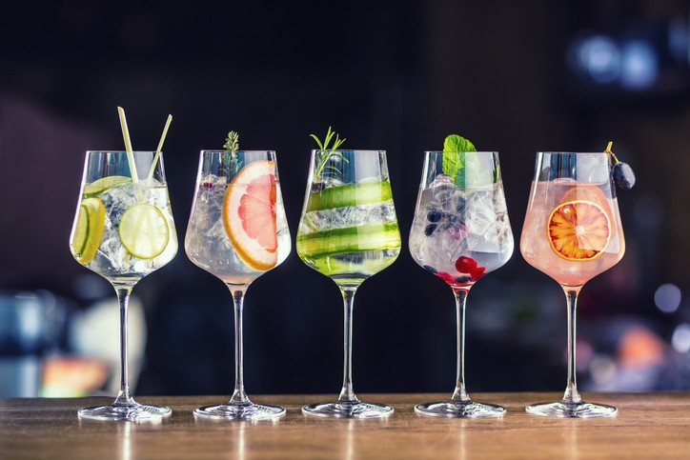

GOAL 3 BREAKDOWN
Constantly pushing the product on social media and websites via contests, promotional holiday events and new product sales etcetera
Monitor Revenue KPI and see quarterly if we are meeting the set criteria. If not, make realistic changes to the overall objective.
Increasing engagement and brand value amongst consumers by positioning the product as an innovative and sustainable purchase. Advertise using our partners (Ooho) to gain credibility and favourable PR to increase the conversion rate.

Slide 38
Timeline
Implementation
Year 1
Jan | Feb | March | April | May | June | July | Aug | Sep | Oct | Nov | Dec
Product launch party (New Years Eve)
Social media campaign launches
Establish relationships with brand representatives/ambassadors
Quarterly check in
Personal selling events (University's, Liquor stores, concepts, sporting events)
Purchase/conduct market research on market trends
Look at increasing amount of retailers offering product
Reach out to potential partnerships in environmentally conscience companies.
Year-end Report
Expansion into Alberta market
‹#›

Slide 39
EVALUATE

Slide 40
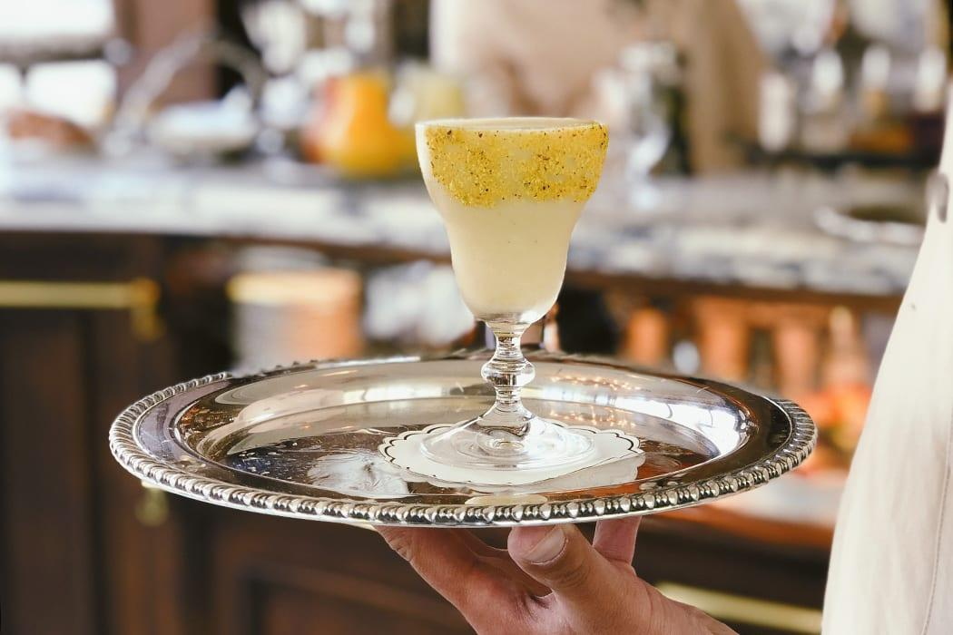
KPIs To Evaluate Profitability
Total Sales Volume
Sales Cost to Volume Ratio
Sales by Social Media/website/affiliation
Revenue
We will measure this KPI regularly by year, quarter and by month. We will create a yearly revenue plan where we map out our expectations, then track our revenue over each quarter and month.
Measures the total volume, in dollars, of sales each month. Create a monthly or quarterly target so that your sales team has a goal. We will adjust it regularly for dips or increases in sales which might occur around seasonal events or holidays.
Making a sale is almost never free. A good chunk of our budget will probably go into each sale, with costs like salary, commissions, marketing costs, etc. That’s why it’s important to measure our sales expenditures vs. what our sales team is generating. This will help us see if our sales team is operating efficiently or not.
This helps us see which channels are bringing in the most revenue and which are underperforming.
(Olafson, 2021)

Slide 41
KPIs To Evaluate Profitability
MAIN FOCUS
Revenue: Compare it to our yearly plan to see if we’re meeting our goals or if our initial yearly plan needs to be adjusted to meet more realistic expectations.

Slide 42
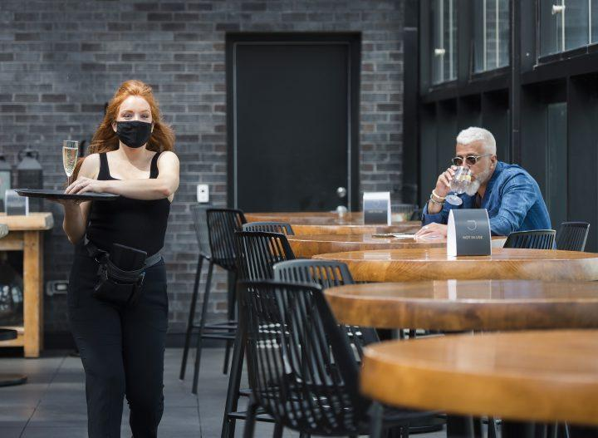
KPIs To Evaluate Brand Success (COVID-19)
Conversion Rate
Social Media Engagement Rate
Customer Lifetime Value
This KPI measures how many conversions, or sales, we get compared to traffic. This will help us analyze the traffic on different channels and compare it to the sales we are getting from each, respectively, which will allow us to take measures to control our spending and allocate it efficiently.
This metric divides all the engagement a post will receive, which includes the likes it received, total comments, saves, story re-shares, by the total number of followers on SOUR’s social media. This will show how engaging, on average, each post/content is.
Customer relationships are important, but it’s necessary to know how much value each client will bring to SOURs’ business. Customer lifetime value calculates how much monetary value we get from a client’s entire purchase history with our company.
(Olafson, 2021)

Slide 43
KPIs To Evaluate Brand Success (COVID-19)
MAIN FOCUS
Social Media Engagement Rate:This will show how engaging, on average, each post/content is. Hence, allowing us to directly analyze SOUR’s social media content & respond to trends accordingly. Especially, changes in environment and how that affects the consumption of our drink (COVID-19, for example).

Slide 44
Control

Slide 45
Sour Pods isn’t just a brand of cocktail, it’s a brand of innovation and a leader of its industry. In saying this, Sour Pods looks to maintain the image of always being at the forefront by constant monitoring of consumer behaviour by using social media platforms effectively, actively seeking feedback from consumer experiences by monitoring the reviews and analyzing the phone/chat customer-care experiences, always looking for emerging unique market opportunities, and actively looking for better ways to deliver value to their consumers.
The next few slides will explain how we plan on maintaining our brand vision, what changes might take place and how the brand plans to stay engaged with its customers.
SOUR
Cheers to the people who make change.

Slide 46
During the end of each quarter, we will conduct a quick evaluation period that will involve: following up on reports created via Google Analytics and other software to track SOURs’ performance on various channels. The benchmark will be the goals set out, as mentioned before, and the KPIs will be used to track their progress.
WHY?
This will help us understand if we are working towards these goals and whether they are realistic.
Continuous A/B testing of strategies will help us understand our forte and see what works. Since we are a startup, this phase is very crucial for long-term success (to develop niche strategies and brand value).
This short-term quarterly part of the evaluation process will allow SOUR to keep up to date with their monthly performance and track their performance. The data gather will then be used for long-term year end reports and make changes to the COMPANY GOALS and OBJECTIVES, if required.

Slide 47
A year-end marketing report will be prepared, that will entail the same information but from all quarters combined. This will help us track our progress and see which strategies are working in our favour and which aren’t. This will also go along will checking the cash flow and the financial performance of the company, to prepare for the next fiscal year.
This part of the Evaluation process will allow the team to see where things went wrong and how to get them back on track. And then new or modified SMART goals will be set, keeping the company objective, values and vision in mind, for the next year.
Year-End Marketing Report

Slide 48
Cheers.

Slide 49
Situational ANalysis
(Component 1)

Slide 50



Who are we?
Situational Analysis
“We combine cocktails at home with environmentally friendly packaging.”
Product doesn’t contain any alcohol, only the mixer- allows for us to sell our product anywhere.
We will be using seaweed pods sourced from Ooho, who are based out of Europe. Seaweed is an eco-friendly alternative to current products.
SOUR is a brand new, revolutionary product that addresses a massive market gap.
‹#›

Slide 51
What are our strengths and weaknesses?
Situational Analysis
Internal Strengths
Internal Weaknesses
First company with completely compostable packaging
Cost-efficient business-model
The whiskey-based RTD market is fairly untapped. Whiskey Invest Direct (2020) reports that, “RTD sales volumes will have risen by 43% during 2020 and projects that it will maintain a compound annual growth rate of +21.8% up to 2024”
Cost per-unit will allow for profits to quickly be achieved with minimal sales required
Sour Pods will collaborate with ‘Ooho’, the brand which received a lot of praise for their environmentally-sustainable technology. Therefore, this will add credibility to our company’s name, promote goodwill and start healthy relationship with our target consumer.
It is a start-up business, the recognition and brand presence are nil
Heavy investments required, unsure revenue & many expenses
Extra caution is required to ensure that each batch of Sour Pods meets the North American Health and Food standards
COVID-19 will cause delays in imports of pods from England. A report from Statistics Canada (2021) states that “consumption goods saw a -12.3% decline from just January 2020 to June 2020”
COVID-19 will also affect our services as the shipping of products to customers, might experience delays
Insight: Though there are startup risks, the cost efficient business model, product differentiation, and external industry trends make this a viable business
‹#›

Slide 52
Cost Components
Product Cost Breakdown
Item | Cost
1-ounce lime juice | $0.03 (Walmart.ca)
1-ounce simple syrup | $0.059 (Walmart.ca)
Ooho packaging | $0.002 (Ooho.com)
Delivery (1 ounce) | $0.16
Egg White | $ 0.70
Advertising Ad Cost | $0.35
= $0.801
Insight: Affordable cost components make it easy to penetrate the market with a low price point
Notes:
*The table shows costs components for SOUR PODS for every 1 serving:

Slide 53
Insight: Deeper Dive
Product Costs + TAM consumers estimated sales per capita = With our product costs being under a dollar per unit, we will be able to mass produce Sour Pods at a relatively affordable price. With our TAM consumer predicted to spend $5.45 per capita on RTD whiskey based cocktails, our product will fit right onto that price range and be attractive to our target consumers. By producing an affordable product we also hope to entice trials and gain consumers from outside our traditional whiskey consumers or non-RTD consumers. We aim to use our low product costs to our advantage, and will allow us to scale effectively to our market size as it grows.

Slide 54
What is our market size?
Market Sizing
TAM
FACT: Per capita sales of spirits, Canada, 2019/20 = CA$190.1 (StatCan., 2021)
FACT: Spirits market share of whiskey, Canada, 2019/20 = 29.9% (StatCan., 2021)
= CA$56.84 (-> estimated per capita sales of whiskey, Canada, 2019/20)
FACT: As of June 2016, 14% Canadian of age 18-34 years old mostly consumed mixed drinks or cocktails among all other alcoholic beverages (Forum Research, 2016)
FACT: In the last three years, RTD alcoholic beverages were most often consumed (light) alcoholic beverages in the U.S. And the trend shows that it is becoming more popular in the recent years, with 47% share of respondents in 2020 (WTWH Media, 2021)
SAM
SOM

Slide 55
What is our market size?
Market Sizing
Serviceable Addressable Market (SAM)
Market size = population of Canada * estimated per capita sales
= 38 million * 2.56
= 97.2 million
18-34 years old; otherwise, they would much prefer to drink outside, e.g. at a bar or drink something better
Likes mixed drinks and cocktails
Also likes to drink whiskey
Finally, has a preference for RTD alcoholic beverage
TAM
SAM
SOM
Constraints:
Estimated per capita sales of whiskey infused mixed drinks or cocktails, Canada, 2019/20 = 56.84 * 14%
= CA$7.96
Now, estimated per capita sales of RTD whiskey drinks, Canada 2019/20 = 7.96 * 47%
= CA$3.74

Slide 56
What is our market size?
Market Sizing
TAM
SAM
FACT: Annual CPI of non-alcoholic beverages in Canada in 2020 was 130.3 (StatCan., 2021)
68.5% of per capita sales of spirits, Canada, 2019/20
Now, we will use the ratio of CPI of non-alcoholic beverages (2020) and per capita sales of spirits to calculate the estimated per capita sales of sour pods in Canada.
Estimated per capita sales of sour pods = 3.74 * 68.5% = CA$2.56
SOM

Slide 57
What is our market size?
Market Sizing
Total Addressable Market (TAM)
For our TAM consumers, we can define them without the constraint of having preference for RTD beverages. This is because RTD alcoholic beverages are a fairly new category of alcoholic beverages and its popularity is expected to increase in coming years.
Estimated per capita sales of sour pods = 7.96 * 68.5%
= CA$5.45 (more than double of SAM)
TAM
SAM
SOM

Slide 58
What is our market size?
Market Sizing
Serviceable Obtainable Market (SOM)
For our SOM consumers, we can define them by adding additional constraints to our existing SAM constraints. One such could be that our consumers are mostly likely to drink sour pods at their home or some other specific settings
FACT: As of 2015, most common alcohol drinking occasions among Canadians are:
In the first rank, ‘consumed when relaxing/after work/ working around home’ which is our more specific target consumer- 27% (Nationalpost.com, 2015)
FACT: In the second rank, ‘while watching a game’, also our target consumer that we want to incorporate - 21% (Nationalpost.com, 2015)
Therefore, estimated per capita sales of sour pods = 2.56 * 48%
= CA$1.23 (more than about half of SAM)
TAM
SAM
SOM

Slide 59
What are some industry trends we can address?
Industry Analysis
FACT: Alcohol ecommerce grew by more than 40% in 2020
Opportunity to establish ourselves in a relatively new online marketplace for at home cocktails
Few competitors in this space

Slide 60

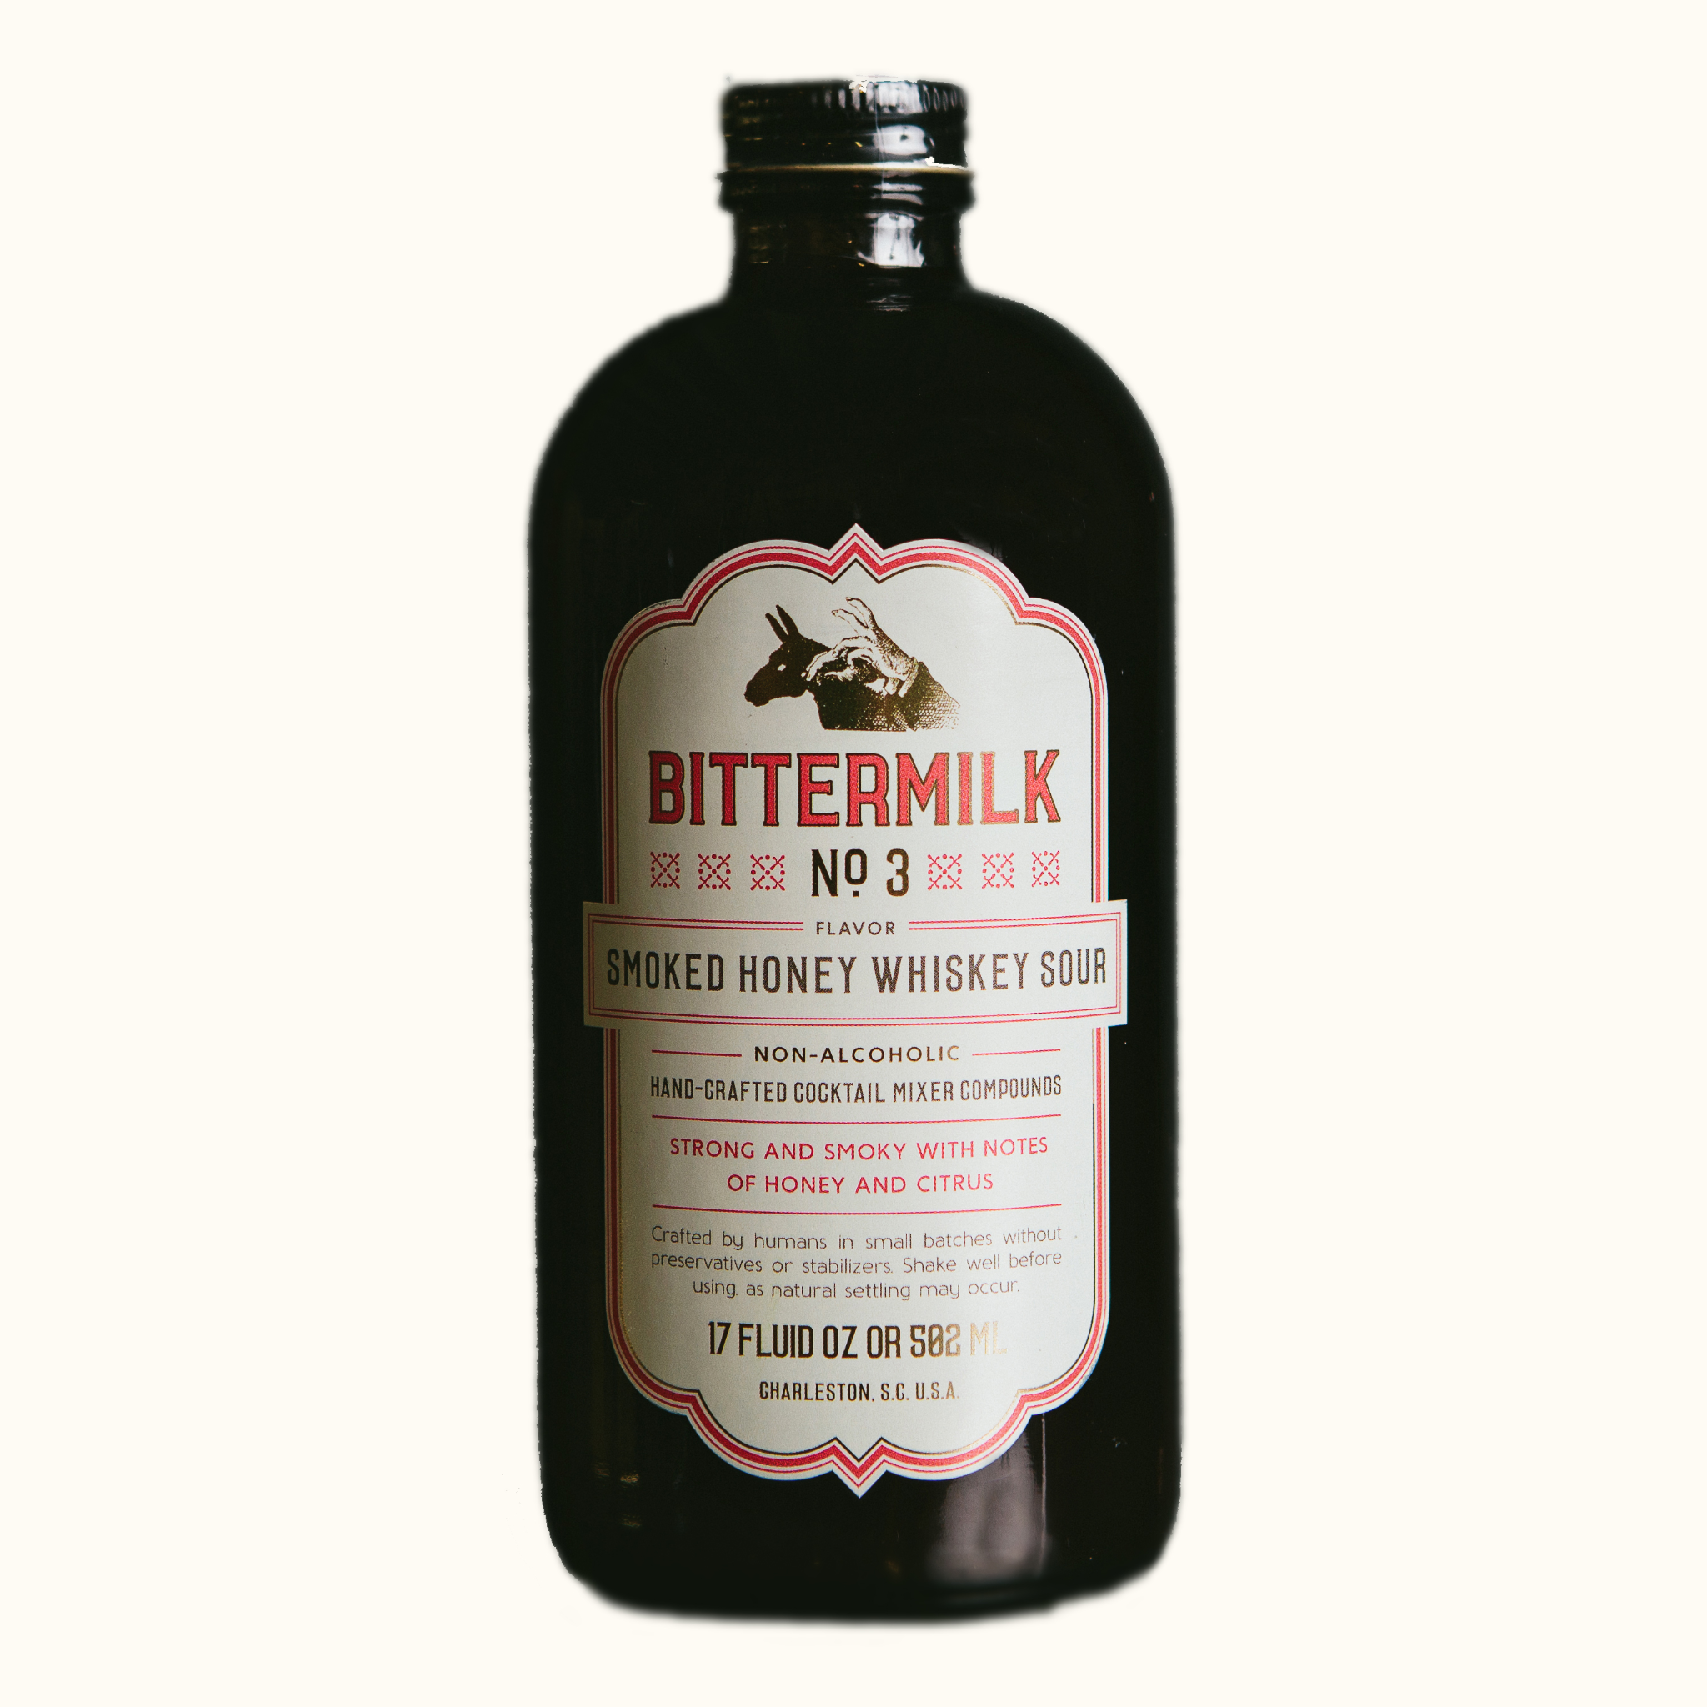
Who are our competitors?
Competitor Analysis
Selection Criteria: Comparable size, Value proposition, Mission alignment , Location
Competitor Insights
1
High
Other whiskey sour pods require the use of a cocktail machine to serve
2
Eco-Friendliness
Competitors packaging is not eco-friendly and relies heavily on the use of plastics. This does not support social and economic trends
Low
Creating a low-price, eco-friendly sour product is a strong differentiator amongst competitors
Low
Price Point
High
‹#›

Slide 61
Case Study: Mr. and Mrs. T
Competitor Analysis
Mr & Mrs T offer a cheap low quality whiskey sour mixer that would be targeted to either first time consumers of the cocktail or those looking for a cheap mixer that resembles the taste of a whiskey sour. Their packaging is not environmentally friendly as it is sold in a plastic bottle and long term storage is questionable after the bottle is unsealed. One of the great benefits of our whiskey sour is that we use capsules (or pods) to preserve the flavour in each serving.

Slide 62
Case Study: Mr. and Mrs. T
Competitor Analysis
The Bartesian Whiskey Sour Cocktail Mix is our closest competitor since they offer a relatively high quality whiskey sour served in capsules. We believe that by sourcing our ingredients overseas we will be able to offer a high quality product and position ourselves at the top end of the market. Our pods will also be compatible with all cocktail mixers this way we can still target our competitors customers without forcing them to purchase new equipment.

Slide 63
Speculative Assumptions and Insights (CDSTEP)
Competitor Analysis
Pods are still a new concept in the alcohol industry however advancements in technology have allowed us to offer a longer lasting and better tasting whiskey sour than our by-the-bottle competitors
Shifts in social and economic trends have put an emphasis on preserving the environment and that is why part of our mission with our whiskey sour pods concept is to offer a sustainable and eco-friendly alternative to plastic bottles
By establishing ourselves as an ecommerce business, we will be able to get a solid foothold in the current market as we can cast a wider net to our target market
We also plan on capitalizing on the impact of COVID-19 by positioning ourselves as a restaurant style cocktail served at home.

Slide 64
Insight: Partnership with Ooho
Partnership with Ooho + Competitors lack of environmentally-friendly packaging = By partnering with Ooho, we have been able to make Sour Pods a completely biodegradable product, leaving no waste behind for future generations. None of our competition offer this, mainly using plastics or glass for their packaging. With the socio-economic trends shifting towards green solutions, we see this as an amazing opportunity to be a market leader. By having this distinct advantage, this is most definitely a factor we will be promoting during our marketing campaign.

Slide 65
STP ANalysis
(Component 2)

Slide 66
Segmentation

Slide 67
Considering startup limitations, SOUR will start its journey in Canada. This is ensuring that our beginning considers both internal company strengths (strong BC roots) and external market factors. Being a startup business, the main decision criteria in deciding an ideal target segment is cost of obtaining the desired data, and potential market growth.
SOUR
Cheers to the people who make change.

Slide 68

Young millennials living in rural areas that are environmentally conscious
Potential Segment #1
Demographic:
Age
Geographic:
Rural
Psychographic:
Environmentalist lifestyle
Segments
Fact 1: The highest consumption of alcohol in Canada is by those ages 18-34 years old at 33.5%, followed by 35-49 years old at 28.4% (McDiarmid, 2019)
Fact 2: Canadians residing in rural areas are more likely to report heavy drinking (22.4%) compared to those living urban areas (18.4%) (McDiarmid, 2019)
Fact 3: 58% of millennials say that they consider sustainability while shopping (Emmert, 2021)
Facts
Demographic:
Adults aged 18-34 years old
Geographic:
Canadians in rural areas
Psychographic:
Those who are environmentally conscious
Target Segmentation
Variables

Slide 69
Young millennials living in rural areas that are environmentally conscious
Potential Segment #1
Demographic:
Age
Geographic:
Rural
Psychographic:
Environmentalist lifestyle
Segments
Fact 1: The highest consumption of alcohol in Canada is by those ages 18-34 years old at 33.5%, followed by 35-49 years old at 28.4% (McDiarmid, 2019)
Fact 2: Canadians residing in rural areas are more likely to report heavy drinking (22.4%) compared to those living urban areas (18.4%) (McDiarmid, 2019)
Fact 3: 58% of millennials say that they consider sustainability while shopping (Emmert, 2021)
Insight: Since the majority of millennials are inherently environmentally conscious and psychographic data is costly to obtain, it is not necessary to strategize using this data.
Facts
Demographic:
Adults aged 18-34 years old
Geographic:
Canadians in rural areas
Psychographic:
Those who are environmentally conscious
Target Segmentation
Variables

Slide 70

Those located in BC that drink at home
Potential Segment #2
Behavioural:
Convenience
Geographic:
BC
Segments
Fact 1: 20% of Canadians who drink alcohol and have been staying at home more due to the COVID-19 pandemic (Canadian Centre on Substance Use and Addiction, 2020)
Fact 2: Whiskey is the favorite beverage of 20% of British Columbians; this is the highest across the country (Conway, 2020)
Facts
Fact 3: 58% of Canadians drink at home, and 16% at someone else's house for a combined 74% (Boesveld, 2015)
Behavioural:
Those who consume mostly when at home
Geographic:
Those who reside in British Columbia
Target Segmentation
Variables

Slide 71
Those located in BC that drink at home
Potential Segment #2
Behavioural:
Convenience
Geographic:
BC
Segments
Fact 1: 20% of Canadians who drink alcohol and have been staying at home more due to the COVID-19 pandemic (Canadian Centre on Substance Use and Addiction, 2020)
Insight: Considering the costs of obtaining further behavioural data and the fact that the majority of Canadians are at home drinkers, segmenting behaviourally is not necessary for SOUR.
Fact 2: Whiskey is the favorite beverage of 20% of British Columbians; this is the highest across the country (Conway, 2020)
Facts
Fact 3: 58% of Canadians drink at home, and 16% at someone else's house for a combined 74% (Boesveld, 2015)
Behavioural:
Those who consume mostly when at home
Geographic:
Those who reside in British Columbia
Target Segmentation
Variables

Slide 72

Young millennials residing in urban British Columbia
Potential Segment #3
Demographic:
Age
Geographic:
Location and Density
Segments
Fact 1: 14% of Canadians aged 18-34 years old mostly consume mixed drinks or cocktails among all other alcoholic beverages (Forum Research, 2016).
Fact 2: On average, the frequency of alcohol consumption is 17.5% higher in middle-high income Canadians (Conway, 2020)
Facts
Fact 3: Vancouver has a rural-urban income inequality that is 2.5x higher than the national average (Fong, 2017)
Demographic:
Young millennials aged 25-34 align with psychographic variables and the ideal age demographic
Geographic:
Those who reside in urban British Columbia are most likely to enjoy whisky sours
Target Segmentation
Variables

Slide 73

Young millennials residing in urban Alberta
Potential Segment #4
Demographic:
Age
Geographic:
Location and Density
Segments
Fact 1: Calgary has a rural-urban income inequality that is 4x higher than the national average (Fong, 2017)
Fact 2: 48% of Canadians' most common alcohol drinking occasions are when relaxing after work, or working at home, and while watching a sports game (Nationalpost.com, 2015).
Facts
Fact 3: 10% of Albertans say that their favourite drink is whisky; second-highest in the country (Conway, 2020)
Demographic:
Young millennials aged 25-34 align with psychographic variables and the ideal age demographic
Geographic:
Alberta’s urban environment is significantly higher income than the rural demographic; they consume more drinks
Target Segmentation
Variables

Slide 74
Young millennials residing in urban Alberta
Potential Segment #4
Demographic:
Age
Geographic:
Location and Density
Segments
Fact 1: Calgary has a rural-urban income inequality that is 4x higher than the national average (Fong, 2017)
Reasoning to separate BC and Alberta:
When looking at the psychographic traits associated with the differing demographic data in those who reside in BC vs Alberta (for example employment), it is important to have different messaging strategies when it comes to marketing a product.
These differing psychographic traits can include values and opinions and require different marketing messaging and strategies to target.
Fact 2: 48% of Canadians' most common alcohol drinking occasions are when relaxing after work, or working at home, and while watching a sports game (Nationalpost.com, 2015).
Facts
Fact 3: 10% of Albertans say that their favourite drink is whisky; second-highest in the country (Conway, 2020)
Demographic:
Young millennials aged 25-34 align with psychographic variables and the ideal age demographic
Geographic:
Alberta’s urban environment is significantly higher income than the rural demographic; they consume more drinks
Target Segmentation
Variables

Slide 75



Finding the right target segment
Segmentation
Segment #1
Environmentally-conscious millennials
Segment #2
BC at-home drinkers
Segment #3
Urban BC millennials
Segment #4
Urban AB millennials
Core Competency Alignment
*BC-based
*BC-based
Segment Growth Potential
Implementation Feasibility
*data cost is high
*data cost is high
Psychographic data is difficult to obtain, therefor, not conducive to a startups’ environment
Gen-Z’s commitment to sustainability lags millennials; the perception is that it is costly to shop sustainably (Emmert, 2021)
Income inequality between rural and urban environments is continuously rising (Fong 2017)
After establishing a BC base, SOUR can expand easily into its neighbouring province
Additional
Insights

Slide 76
Finding the right target segment
Segmentation
1
2
Segment #1
Environmentally-conscious millennials
Segment #2
BC at-home drinkers
Segment #3
Urban BC millennials
Segment #4
Urban AB millennials
Core Competency Alignment
*BC-based
*BC-based
Segment Growth Potential
Implementation Feasibility
*data cost is high
*data cost is high
Psychographic data is difficult to obtain, therefor, not conducive to a startups’ environment
Gen-Z’s commitment to sustainability lags millennials; the perception is that it is costly to shop sustainably (Emmert, 2021)
Income inequality between rural and urban environments is continuously rising (Fong 2017)
After establishing a BC base, SOUR can expand easily into its neighbouring province
Additional
Insights
Key insight: In order to best align with SOUR’s internal strengths (core competencies), we should prioritize targeting the urban BC millennial segment and also target the the urban Alberta millennial segment

Slide 77
By analyzing the data above we can make insights towards where we should target our consumers by province. With 20% of British Columbians stating their favourite drink is whiskey, this is the largest market. At 10% for Alberta, Western Canada will provide us with the most consumers compared to Eastern Canada. The most likely venue for Canadians to consume alcohol is at their own home or a friends. Since our product comes prepackaged and is designed to be enjoyed at home, targeting consumers who are looking for a premade cocktail to enjoy in the comfort of their own homes is a message we need to convey to our audience. Through targeting the urban millennial demographic within BC and Alberta, we are effectively meeting our psychographic and behavioural criteria, all while remaining within the constraints of our startup model. This marketing model leaves room to expand across the country as the business grows.
SOUR
Cheers to the people who make change.

Slide 78
Targeting

Slide 79
Finding the right target strategy
Segmentation
Undifferentiated
Targeting
Differentiated
Targeting
Concentrated
Targeting
Micromarketing
Targeting
Cost Efficiency
Reachable Audience
Receptiveness
To Message
Targets Multiple Segments
Additional
Insights
Whiskey Sour is a highly niche market
There are multiple segments within the Whiskey Sour niche
Does not consider other market segments within the niche market
Ineffective for small business with widespread audience

Slide 80
Finding the right target strategy
Segmentation
Undifferentiated
Targeting
Differentiated
Targeting
Concentrated
Targeting
Micromarketing
Targeting
Cost Efficiency
Reachable Audience
Receptiveness To Message
Targets Multiple Segments
Additional
Insights
Whiskey Sour is a highly niche market
There are multiple segments within the Whiskey Sour niche
Does not consider other market segments within the niche market
Ineffective for small business with widespread audience
Key insight: Differentiated marketing allows us to be specific and cost efficient with our marketing while also targeting multiple segments of the niche market.

Slide 81
We will use a differentiated targeting strategy as it fits best within our market segment. Whiskey sour is a niche market consisting of people who are passionate about certain aspects of the drink itself. People that enjoy whiskey sour have a particular persona and share certain qualities that can be targeted in our marketing campaign. The cocktail mixer market is approximately 86 billion USD as of 2021. In terms of a resources perspective, differentiated targeting will allow us to effectively penetrate multiple segments simultaneously while keeping ad spend relatively low.
SOUR
Cheers to the people who make change.

Slide 82
Positioning

Slide 83
Sour Pods is looking to position itself not only as a quality cocktail provider for the masses but also as a convenient brand. with innovative, ahead of the curve leader in environmentally friendly packing that their consumers can be proud to use. Its consumers can enjoy their premium cocktail knowing they made an environmental conscious choice while taking in the perfectly proportioned cocktail, every time.
SOUR
Cheers to the people who make change.

Slide 84



Positioning map
Competitor Analysis
Selection Criteria: Environment-friendly, Preparation Time, Retail Price, Convenience to make, Convenience to Buy
Competitor Insights
1
High
SOUR
Competitors packaging is not eco-friendly and relies heavily on the use of plastics. This does not support social and economic trends.
2
Eco-Friendliness
Competitors sacrifice convenience for eco-friendliness - there is a gap in the market for those that offer both.
Low
Creating an eco-friendly, and convenient sour product is an opportunity to differentiate amongst competitors
Low
Convenience
High
‹#›

Slide 85
Positioning Map- Decision Criteria
 | Environment friendly | Preparation Time | Retail Price | Convenience to make | Convenience to Buy
SOUR | 5 | 4 | 5 | 4 | 4
Bartesian | 2 | 4 | 3 | 3 | 2
Dogfish | 1 | 5 | 4 | 4 | 3
Lyre's G+T | 3 | 5 | 2 | 4 | 4
Coit Paradisio | 1 | 4 | 1 | 5 | 2
Sodas | 1 | 3 | 5 | 3 | 5
Reasoning
To understand the competitors better, we ranked them on a scale of 1 to 5. This will help us compare and analyze Sour’s positioning in the market.
5= Excels in the criteria
4= Adopts the criteria
3 = Acknowledges the criteria
2= Relates to the criteria
1= Fails the criteria
Insights: According to our analysis, environment-friendly & convenience rule out to be the top two most important criterias for Sour, when deciding on their positioning strategy in the market.

Slide 86
Reasoning
Positioning Map- Decision Criteria
Environment- Friendly: Sustainability has become a top priority for consumers when making buying decisions. 32% of total alcohol consumers want to engage in adopting an eco-friendly lifestyle (Deloitte, 2021).
Preparation Time: The RTD market has grown 43% globally (Swartz, 2020). People value time and want to know what they’re putting in their body.
Retail Price: Price is important, there’s no doubt in that. A study published by National Institute of Health shows that the brand choice that consumers make while purchasing their beverage, is directly linked to the price offering of the brand (National Institute of Health, 2015)
Convenience to Make: Thanks to the pandemic, now more than ever, the ability to make cocktails from the comfort of your home is in trend. Consumers want to have fun and be adventurous (Swartz, 2020).
Convenience to Buy: Although consumers value price & quality, but in a survey conducted by Smart Insights, 52% respondents said that convenience influences their purchase (Smart Insights, 2020)
POSITIONING STATEMENT: “To whiskey drinkers who are looking for a better mixer than the same old sodas, Sour Pods is a quality mixer that conveniently gives you a quality cocktail in the comfort of your own home, while also allowing you to make environmentally friendly choice over traditional cans or bottles”.

Slide 87
References
Barton, J. (2019). How Much Do Instagram Ads Cost. SEO Resellers Canada. Retrieved from https://seoresellerscanada.ca/how-much-do-instagram-ads-cost/
Barton, J. (2019). Your Guide to YouTube Ads: How Much Does YouTube Advertising Cost. SEO Resellers Canada. Retrieved from https://seoresellerscanada.ca/your-guide-to-youtube-ads-how-much-does-youtube-advertising-cost/
Bedford, E., (2019, November 28). Domestic Beer Consumption Canada Age Group 2019. Statisa. https://www.statista.com/statistics/339801/beer-consumption-in-canada-by-gender-and-age-group/
Boseveld, S. (205, May 15). How we drink: Here's everything you need to know about Canadians' overall boozy habits. National Post. https://nationalpost.com/life/how-we-drink-from-how-much-to-how-often-heres-everything-you-need-to-know-about-canadians-boozy-habits
https://www.canadapost-postescanada.ca/blogs/business/ecommerce/looking-to-attract-the-canadian-millennial-shopper-get-to-know-them-first/#:~:text=With%2080%25%20of%20Canadians%20now,drives%20this%20group's%20buying%20patterns.
Canadian Centre on Substance Use and Addiction. (2020, June 9). More than 1 in 5 Canadians who drink alcohol and have been staying at home more have been drinking once a day since the beginning of May. GlobeNewswire News Room. Retrieved November 9, 2021, from https://www.globenewswire.com/en/news-release/2020/06/09/2045685/0/en/More-than-1-in-5-Canadians-who-drink-alcohol-and-have-been-staying-at-home-more-have-been-drinking-once-a-day-since-the-beginning-of-May.html.

Slide 88
References
Conaway, J. (2020, December 1). Total Alcohol Consumption in Canada. Statista. https://www.statista.com/topics/2998/alcohol-consumption-in-canada/
Connelly, J. (2019, June). Average B.C. home costs three times more than Millennials can afford: Study. Western Investor. Retrieved November 30, 2021, from https://www.westerninvestor.com/british-columbia/average-bc-home-costs-three-times-more-than-millennials-can-afford-study-3831594.
Crandall, P.G., Mauromoustakos, A., O’Bryan, C.A., Thopmson, K.C., Yiannas, F., Bridges, K., Francois, C. (2017). Impact of the Global Food Safety Initiative on Food Safety Worldwide: Statistical Analysis of a Survey of International Food Processors. Journal of Food Projection. 80(10). 1613-1622.
https://doi.org/10.4315/0362-028X.JFP-16-481
Emmert, A. (2021, July 8). The rise of the eco-friendly consumer. strategy+business. Retrieved November 9, 2021, from https://www.strategy-business.com/article/The-rise-of-the-eco-friendly-consumer.
Evans, P. (2019, April 23). Millennials make more than previous generations, but owe much more too, StatsCan numbers confirm | CBC News. CBCnews. Retrieved November 30, 2021, from https://www.cbc.ca/news/business/millennials-income-statistics-canada-1.5106460.
Forum Research. (June 8, 2016). Type of alcoholic beverage most commonly consumed by adults in Canada as of June 2016, by age group [Graph]. In Statista. Retrieved November 09, 2021, from https://www-statista-com.proxy.lib.sfu.ca/statistics/587682/alcoholic-beverage-most-consumed-canada-by-age/

Slide 89
References
Fong, F. (2017). Income Inequality in Canada: The Urban Gap. Retrieved November 10, 2021, from file://Downloads/G10363-SC_Income%20Inequality%20in%20Canada%20-%20The%20Urban%20Gap_FINAL_ENG.pdf.
Ipsos. (2015, May). Alcohol: drinking occasions in Canada 2015. Statista. Retrieved November 9, 2021, from https://www-statista-com.proxy.lib.sfu.ca/statistics/434629/alcohol-drinking-occasions-among-canadians/. Jan Conway, & 24, N. (2020, November 24). Favorite alcoholic beverages canada by province 2018. Statista. Retrieved November 9, 2021, from https://www.statista.com/statistics/896012/favorite-alcoholic-beverages-canada-by-province/.
Katen, E., Turner, N. (2019, March 26). New immigrants made up 61% of Canada’s population growth in 2018. CIC News.https://www.cicnews.com/2019/03/new-immigrants-made-up-61-of-canadas-population-growth-in-2018-
Ltd, M. D. (n.d.). Smoothies Market Size, Share, Trend Analysis: North America: Europe: APAC: MEA: LA. Retrieved from https://www.marketdataforecast.com/market-reports/smoothies-market
McDiarmid, C. (2019, June 25). This is a health fact sheet about heavy drinking habits among Canadians aged 12 and older. the results shown are based on data from the Canadian Community Health Survey. Heavy Drinking, 2018. Retrieved November 9, 2021, from https://www150.statcan.gc.ca/n1/pub/82-625-x/2019001/article/00007-eng.htm.

Slide 90
References
National Institute of Health. (November, 2015). Retrieved from https://www.ncbi.nlm.nih.gov/pmc/articles/PMC4192130/
NielsonIQ. (2019, May 21). How newer ready-to-drink beverages and packages are shaking up the adult beverage market. https://nielseniq.com/global/en/insights/analysis/2019/how-ready-to-drink-beverages-and-packages-are-shaking-u p-the-adult-beverage-market/
Olafson, K. (2021, May). 19 19 Social Media KPIs You Should Be Tracking. Retrieved from https://blog.hootsuite.com/social-media-kpis-key-performance-indicators/
Petro, G. (2019, March 29). Consumers are spending more per visit in-store than online. what does this mean for retailers? Forbes. Retrieved December 1, 2021, from https://www.forbes.com/sites/gregpetro/2019/03/29/consumers-are-spending-more-per-visit-in-store-than-o nline-what-does-this-man-for-retailers/.
Ready-to-Drink Cocktails are Growing Fast. (2018, July 6). The Algoma News Review. http://www.thealgomanews.ca/ready-to-drink-cocktails-are-growing-fast
The Pricer. (2016, May 23.). Ohoo the edible water bottle or bubble cost. https://www.thepricer.org/ooho-the-edible-water-bottle-or-bubble-cost/
Spirits Canada. (2019, January 21). Spirits show strong growth in Canada in 2018. https://www.restobiz.ca/spirits-show-strong-growth-canada-2018/
StatCan. (May 31, 2021). Sales value of alcoholic beverages per capita in Canada in 2019/20, by type (in Canadian dollars) [Graph]. In Statista. Retrieved November 09, 2021, from https://www-statista-com.proxy.lib.sfu.ca/statistics/710186/sales-share-of-the-alcoholic-beverages-canada/

Slide 91
References
Statistics Canada. (2021). Impact of COVID-19 on merchandise imports: evidence based on end-use good. Retrieved from https://www150.statcan.gc.ca/n1/pub/13-605-x/2021001/article/00001-eng.htm
StatCan. (May 4, 2021). Market share of spirits in Canada in 2019/2020, by category and region [Graph]. In Statista. Retrieved November 09, 2021, from https://www-statista-com.proxy.lib.sfu.ca/statistics/1265085/spirits-market-share-by-type-and-region-canada/
Smart Insights. (2020). Convenience is driving e-commerce growth and influencing consumer decisions. Retrieved from https://www.smartinsights.com/ecommerce/convenience-is-driving-e-commerce-growth-and-influencing-consumer-decisions/
StatCan. (February 2, 2021). Annual consumer price index (CPI) of non-alcoholic beverages in Canada from 2003 to 2020 [Graph]. In Statista. Retrieved November 09, 2021, from https://www-statista-com.proxy.lib.sfu.ca/statistics/437520/cpi-of-non-alcoholic-beverages-canada/
Smart Insights. (2020). Convenience is driving e-commerce growth and influencing consumer decisions. Retrieved from https://www.smartinsights.com/ecommerce/convenience-is-driving-e-commerce-growth-and-influencing-consumer-decisions/

Slide 92
References
StatCan. (February 2, 2021). Annual consumer price index (CPI) of non-alcoholic beverages in Canada from 2003 to 2020 [Graph]. In Statista. Retrieved November 09, 2021, from https://www-statista-com.proxy.lib.sfu.ca/statistics/437520/cpi-of-non-alcoholic-beverages-canada/
Sustaina. (2018, September 21). Rethink your drink with water capsules. Global Opportunity Explorer. https://goexplorer.org/edible-water-capsules/
Swartz, K. 2020). COVID-19 is Fueling a Home Mixology Movement. Retrieved from https://beveragedynamics.com/2020/08/03/covid-19-home-mixology-cocktails/
Swartz, K. (2020). Why RTDs Will Boom in 2021 and Beyond. Retrieved from https://beveragedynamics.com/2020/11/19/rtds-canned-cocktails-trends-growth-2021/
Trade news. Whats driving the acceleration of online food shopping? - TFO Canada. (2018). Retrieved December 1, 2021, from https://www.tfocanada.ca/news.php?item=4740&amp;.
Vencat, E. (2020, October 19). Top 10 Diet Trends for 2021. Retrieved from https://youbars.com/blogs/news/top-10-diet-trends-for-2021

Slide 93
References
Website (nationalpost.com). (May 15, 2015). Most common alcohol drinking occasions among consumers in Canada as of May 2015 [Graph]. In Statista. Retrieved November 09, 2021, from https://www-statista-com.proxy.lib.sfu.ca/statistics/434629/alcohol-drinking-occasions-among-canadians/
Walmart.com. Retrieved from https://www.walmart.com/ip/Mr-Mrs-T-Bold-Spicy-Bloody-Mary-Mix-1-75-L-bottle/36300569
Wixcey, N. (2014). Deloitte UK Consumer Review Role of the high street. Retrieved December 1, 2021, from https://www2.deloitte.com/content/dam/Deloitte/uk/Documents/consumer-business/deloitte-uk-consumer-review-role-of-the-high-street.pdf.
Woodard, R. (2020). Scotch & RTDs: The Time is Now. Whiskey Invest Direct. Retrieved from https://www.whiskyinvestdirect.com/whisky-news/scotch-rtd-112020201
Costco.com. Retrieved from https://www.costco.ca/realemon-lemon-juice%2c-2-x-3.8-l.product.100546319.htm
WTWH Media. (March 29, 2021). Most often consumed ready-to-drink alcoholic beverages in the U.S. from 2018-2020 [Graph]. In Statista. Retrieved November 09, 2021, from https://www-statista-com.proxy.lib.sfu.ca/statistics/1232410/rtd-alcoholic-beverage-consumption-us/

Slide 94
References
Webstaurantstore.com. Retrieved from https://www.webstaurantstore.com/narvon-1-gallon-simple-syrup-case/515SIMPLESYP.html

